Slide 1
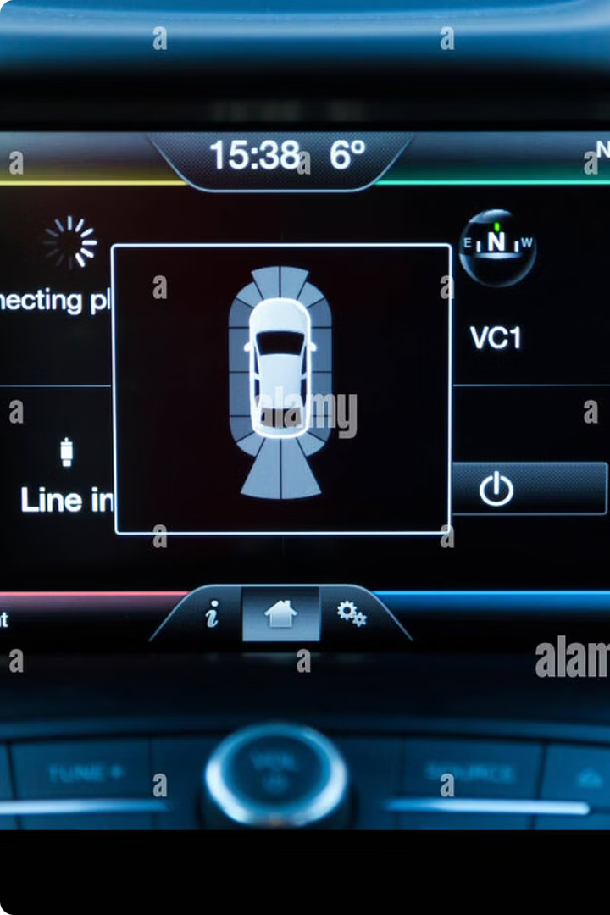
Analyze Sensor Data From Vehicles to Predict Maintenance Needs and Prevent Breakdowns.
Sensor data is revolutionizing vehicle maintenance, enabling proactive prediction of potential issues and optimizing repair schedules.
U.Karthik (192211162)
CH.Eswar (192210671)
S.Mahammad Haneef(192225097)

Slide 2

The Importance of Predictive Maintenance
Reduced Downtime
Lower Maintenance Costs
Predictive maintenance minimizes unexpected breakdowns, reducing vehicle downtime and improving operational efficiency.
Proactive maintenance can identify issues before they escalate, leading to cost-effective repairs and preventing expensive replacements.
Enhanced Safety
By detecting potential safety hazards early, predictive maintenance contributes to a safer driving experience and reduces accident risks.

Slide 3
Key Vehicle Sensor Data for Maintenance Prediction
1
Engine Temperature
2
Engine Oil Pressure
High temperatures can indicate overheating issues, requiring attention and preventative measures.
Low oil pressure can signal a potential oil leak or pump failure, demanding prompt diagnosis and repair.
3
Tire Pressure
4
Brake Pad Wear
Abnormal tire pressure variations can indicate leaks or tire wear, potentially affecting vehicle performance and safety.
Sensors monitor brake pad thickness, providing early warnings of wear and ensuring timely replacement for optimal braking.

Slide 4
Machine Learning Algorithms for Predictive Modeling
Regression Models
Classification Models
Deep Learning Models
Predicting continuous variables, such as time until failure, based on sensor data trends.
Categorizing vehicle conditions into different states, such as "healthy" or "high risk" based on sensor data.
Analyzing complex patterns in large datasets, identifying anomalies and predicting maintenance needs with high accuracy.

Slide 5




Integrating Sensor Data with Maintenance Records
Sensor Data Collection
Maintenance History
Data Analysis and Modeling
Maintenance Scheduling
Real-time data from vehicle sensors is collected and stored in a centralized database.
Historical records of repairs, inspections, and part replacements are integrated into the database.
The system generates alerts and recommendations for timely maintenance based on predicted needs.
Machine learning algorithms analyze sensor data and maintenance records to identify patterns and predict future needs.

Slide 6
Identifying Patterns and Anomalies in Sensor Data
Normal Behavior
Sensor values fluctuate within expected ranges, indicating a healthy vehicle.
Trend Analysis
Identifying gradual changes in sensor readings can reveal potential issues developing over time.
Anomaly Detection
Sudden spikes or dips in sensor data outside the normal range may signal a critical event or malfunction.

Slide 7
Proactive Maintenance Scheduling and Cost Savings
Predictive Maintenance
Cost Savings
The system proactively alerts owners about potential issues before they become major problems.
Early intervention prevents costly repairs, extending vehicle lifespan and minimizing overall maintenance expenses.
1
2
3
Scheduled Maintenance
Maintenance can be scheduled during optimal times, reducing downtime and operational disruption.

Slide 8




Conclusion: The Future of Predictive Maintenance in the Automotive Industry
Increased Efficiency
Reduced Costs
Enhanced Safety
Innovation and Advancement
Predictive maintenance optimizes vehicle performance and reduces downtime, leading to greater efficiency and productivity.
By preventing major breakdowns and scheduling repairs proactively, predictive maintenance significantly reduces maintenance costs.
Predictive maintenance identifies potential safety hazards early, ensuring a safer driving experience for everyone.
The integration of sensor data and AI is driving significant advancements in the automotive industry.

Slide 9

Thank you

